Slide 1
Deliverable 1
Adam Afilaka: Developer/Programmer
Ashley Braun: Business Analyst/Project Manager
Zaid Islam: Cyber Security Engineer
Rithika Sayini: Researcher/Programmer
Shanese Scott: Database Administrator
Xin Zheng: Quality Assurance

Slide 2
System Request
This EMR device tracks vitals and homeostatic imbalance in real time to allow healthcare providers to be able to give you the best possible treatment.
This device also stores recent medical records and a complete medical chart including but not limited to:
Rxs, labs, diagnoses, surgeries, allergies, current medication, current and past treating physician lists, radiology studies, pathology results, immunizations etc.
Our encryption technology allows for the information on this device to only be accessed by you and your healthcare provider.
This device would eliminate most expensive medical screenings and drastically reduce the cost of resources in hospitals.

Slide 3
Business Requirements
There are 12 million Americans misdiagnosed each year. The most common reasons for misdiagnosis include problems with ordering diagnostic tests; failure by the patient to provide an accurate medical history; and errors made by a doctor in interpreting test results.
Provide consistent and reliable info from EMRs to all HCP
Access to the current myChart/patient portal
Access to the current myChart/patient portal
After the device is designed and ready to move to the next phase, we need to conduct clinical trials to test the efficacy and accuracy of the devices and compose the results into a report for approval from FDA.
Conduct clinical trials
Generally, any business entity engaged in medical device manufacturing or trading (distribution and/or sale) must obtain specific licenses in addition to the normal business licenses.
Partnership with licensed manufacturers

Slide 4
Estimated Business Value
 | Sales Projection
 | Hospital Purchase | Subscription (over the course of a year)
High level Estimate Probability: 60% | $5000000 | $20,000,000
Medium Level Estimate Probability: 30% | $2000000 | $10,000,000
Low Level Estimate Probability: 10% | $1200000 | $7,000,000
Weighted Average Expected Sales | 3180000 | $15700000
The wearable device industry is a 120 million dollar industry by 2023. The healthcare industry will be 3.4 trillion dollars industry. So the projections of our project are quite high.
Total: $ 47500000

Slide 5
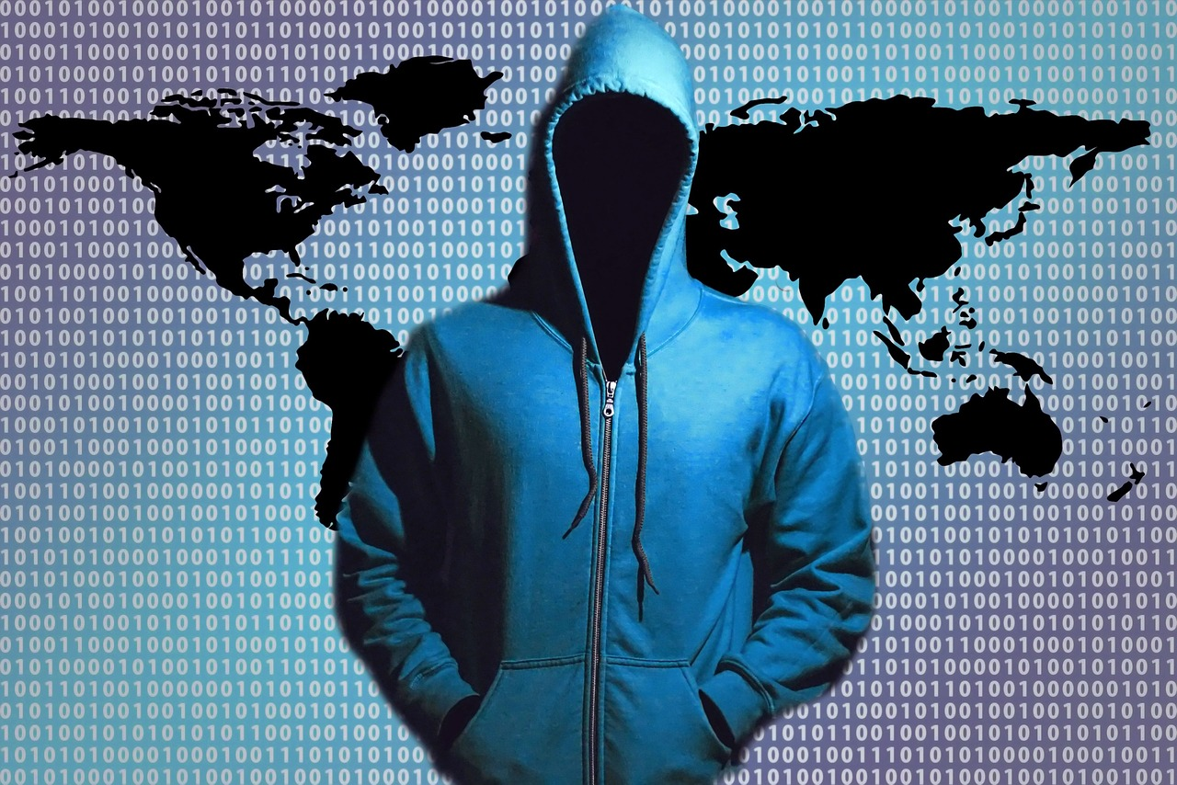

Technical Feasibility: Security
In 2016, on average, at least one health data breach occurred every day, totaling in about 450 successful attacks over the course of the year, according to a report from Protenus.
Hackers have different methods of gaining unauthorized entry, but the phishing attack is the most common. This is usually a legitimate-looking email with an attachment that, if opened, will place malware on the network that gives the hacker access.
Scanning of a person’s EMR should be protected, since the collection of data is constant the software should prevent any ways hackers can connect and begin to record to an end system that records the EMR
VS.

Slide 6
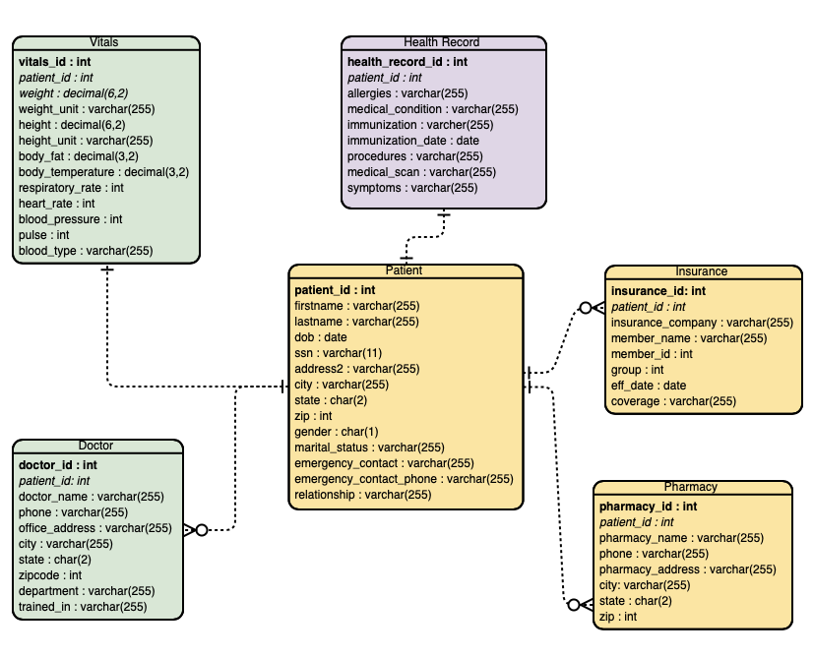
ER Diagram for EMR Data

Slide 7
Software Requirements:
FoundationDB
InnoDB
OS (Linux, Windows, and macOS)
MongoDB
Hardware Requirements:
16-64 GB of RAM
Disk Space 250 GB or higher
8-16 core processor
High speed drive (SAN)
Server Requirements:
32 GB
Database Requirements:
Backup Compression
ACID Properties
Replication
Ordered key-value store
Layers
Challenges:
The system needs a responsive UI
The database will need to be able to handle increased data volumes
The database will need to be able to secure and have user authentication
Precautions to avoid data loss or artificial threats

Slide 8
Economic Feasibility- Cost and Benefits
Development Costs Salary Software Development Hardware Development Data Conversion Hardware and Software Architecture Clinical Trials | Operational Costs Maintenance Salary Hardware Manufacturing Customer Service and Support Outreach
Tangible Benefits Cuts Doctor’s Offices Cost Free Advertising | Intangible Benefits Customer Ease of Mind Faster Patient Care More Efficient Healthcare Faster doctor’s office visits

Slide 9
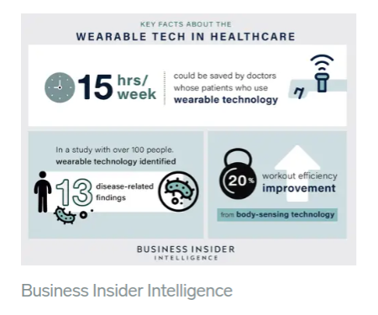
Feasibility Analysis- Organizational
US consumer use of wearables jumped from 9% in 2014 to 33% in 2018, according to Accenture.
More than 80% of consumers are willing to wear fitness technology.
According to Business Insider Intelligence research, the total installed base of fitness tracker and health-based wearables in the US will grow at an annualized rate of 10% to surpass 120 million by 2023.
Healthcare professionals desire this technology
Health IT Professionals and Consulting firms
https://www.businessinsider.com/wearable-technology-healthcare-medical-devices
Business Insider: https://www.businessinsider.com/wearable-technology-healthcare-medical-devices

Slide 10
Feasibility Analysis- Organizational
Special Issues/Constraints:
Privacy issue
HIPAA, HITECH
Availability to all HCPs
Device compatibility
Restricting access to only licensed HCPs (this is already done with patient portals, but needs to be addressed with a device/product)
Patient data cannot be altered by patient.
Blockchain Technology implementation
Not all individuals will carry the product/device
Medical record retention periods (data will have to be phased in and may only go back so many years. This resolves in the future, maybe decades later.)
:

Slide 11
Project Methodology
We are proposing the parallel methodology considering the complexity of the system and the need to be compatible with other systems. Therefore, the development can be tested in phases alongside all the components.

Slide 12
Project work dates
Team Meetings-
Two initial meetings were held on:
Monday, Sept. 23, 2019 (Adam, Rithika, Shanese, Zaid)
Wednesday, Sept. 25, 2019 (Ashley & Xin)
Deliverables -
One - Oct. 2, 2019
Two - TBD
Three - TBD
Four - TBD
Five - TBD
Six - Dec. 2019
Presentations -
One - Oct. 3, 2019
Two - TBD
Three - TBD
Four - TBD
Five - TBD
Six - Dec. 2019

Slide 13
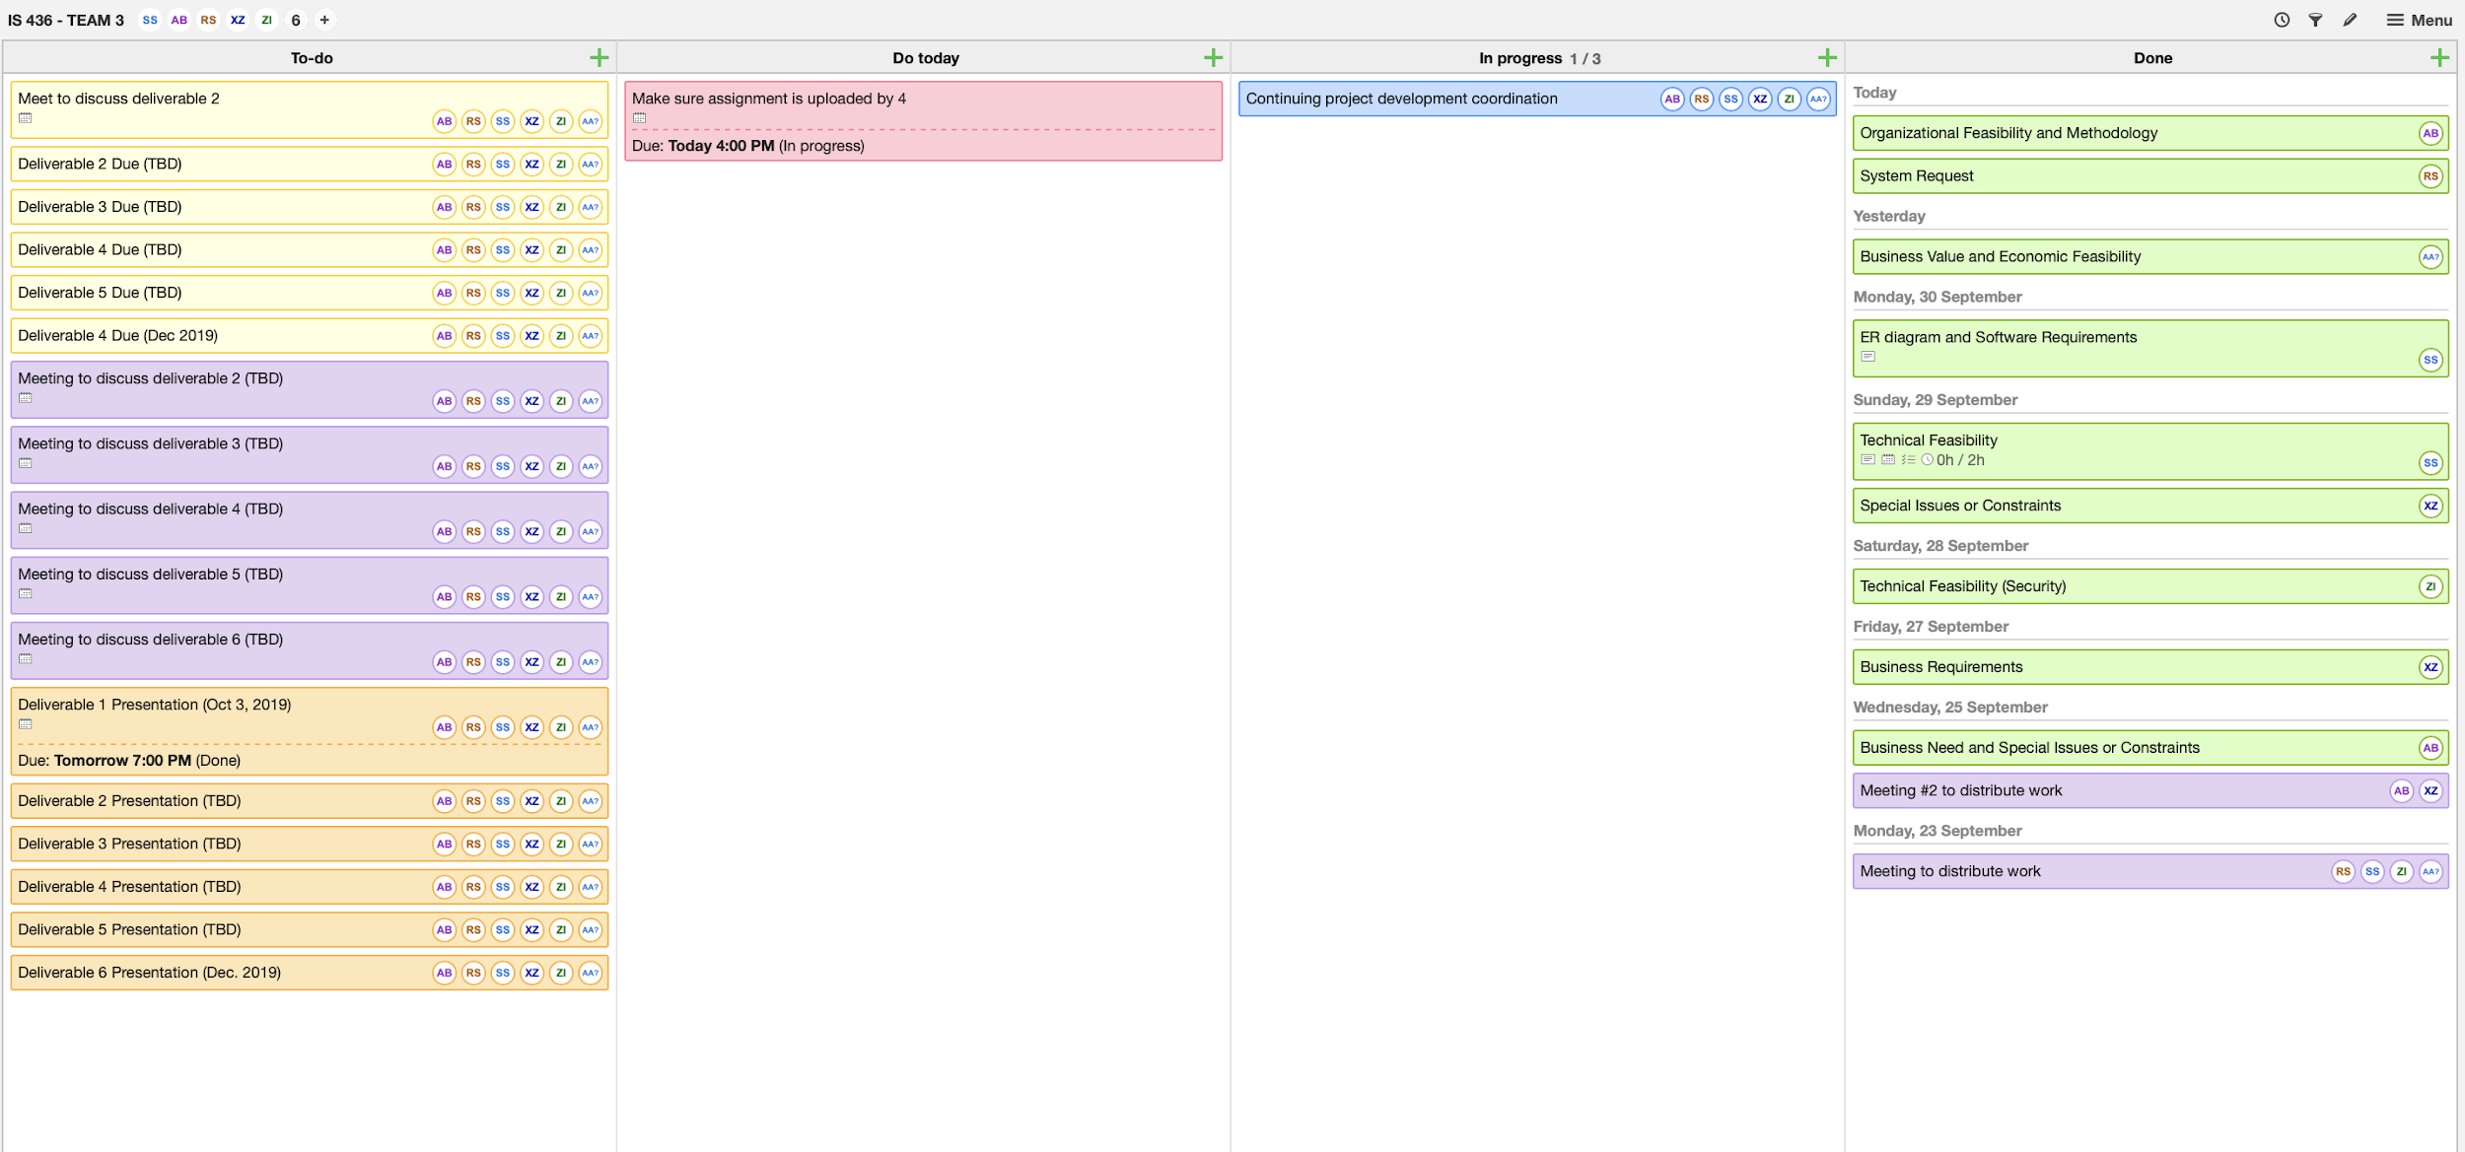
Project tasks

